Slide 1
Introduction to Algorithms

Slide 2
Algorithms
What is an Algorithm ?

Slide 3
Algorithms
What is an Algorithm ?
Method of solving a problem by a finite sequence of instructions.

Slide 4
Algorithms
Is there a problem for which there can not be an Algorithm ?

Slide 5
Algorithms
Is there a problem for which there can not be an Algorithm ?
Print all the Integers
Halting Problem
Hilbert’s tenth problem

Slide 6
Efficient Algorithms ?
NP – Hard problems: Example TSP
Travelling Salesman Problem: If a sales man wants to visit all the cities, what is the best way ?

Slide 7
Efficient Algorithms
There are some problems whose complexity is not known
Factorisation: Given a integer, find it’s factors.
(Primarily-decide if a given number is prime can be solved efficiently).
- Turnpiker Reconstruction problem: There is an algorithm, which works well most of the time ! But no guarantee !

Slide 8
Efficient Algorithms ?
    This course is about designing and analysing efficient algorithms
    The focus will be on developing skills and techniques

Slide 9
Performance of Algorithms
What metric should be used to judge algorithms?
  How many steps does a it take ? (Running time)
  Memory required
Running time is the dominant standard.
  Quantifiable and easy to compare
  Often the critical bottleneck

Slide 10
How long this program takes ?
#include <stdio.h>
void main(){
int i,j,k,n,s;
n=10000;s=2;
for (i=0;i<n;++i)
for (j=0;j<n;++j)
for (k=0;k<n;++k)
s=2*s+1;
printf("%d",s);
}

Slide 11
What is the output ?
#include <stdio.h>
void main(){
int i,j,k,n,a[10000000];
n=1000;
for (i=0;i<n;++i)
for (j=0;j<n;++j)
for (k=0;k<n;++k)
a[i*n*n+j*n+k]=2*i*j*k+1;
}
#include <stdio.h>
void main(){
int i,j,k,n,a[10000000];
n=1000;
for (i=0;i<n;++i)
for (j=0;j<n;++j)
for (k=0;k<n;++k)
a[i*n*n+j*n+k]=2*i*j*k+1;
}

Slide 12
Why Efficient Algorithms Matter ?
Suppose N = 10^8
A PC can process 10N records in 1 sec.
But if some algorithm does N*N computation, then it takes 10M seconds = 110 days!!!
100 City Traveling Salesman Problem.
  A supercomputer checking 100 billion tours/sec still requires 10¹⁰ years!

Slide 13
Asymptotic Notations
Big-O, “bounded above by”: T(n) = O(f(n))
  For some c and N, T(n) ≤ c·f(n) whenever n > N.

Slide 14
Asymptotic Notations
Big-O, “bounded above by”: T(n) = O(f(n))
  For some c and N, T(n) ≤ c·f(n) whenever n > N.
  Example : T(n)=2n²+n-3
  T(n)=2n²+n-3
  < 2n²+n when n>0
  < 2n²+n² when n>0
  < 3n² when n>0
  So, We can say T(n)=O(n²⁾

Slide 15
Asymptotic Notations
Big-O, “bounded above by”: T(n) = O(f(n))
  For some c and N, T(n) ≤ c·f(n) whenever n > N.
Big-Omega, “bounded below by”: T(n) = Ω(f(n))
  For some c>0 and N, T(n) ≥ c·f(n) whenever n > N.

Slide 16
Asymptotic Notations
Big-Omega, “bounded below by”: T(n) = Ω(f(n))
  For some c>0 and N, T(n) ≥ c·f(n) whenever n > N.
  Example : T(n)=2n²+n-3
  T(n)=2n²+n-3
  >2n² when n>3
  So T(n) = Ω(n²)

Slide 17
Asymptotic Notations
Big-O, “bounded above by”: T(n) = O(f(n))
  For some c and N, T(n) ≤ c·f(n) whenever n > N.
Big-Omega, “bounded below by”: T(n) = Ω(f(n))
  For some c>0 and N, T(n) ≥ c·f(n) whenever n > N.
Big-Theta, “bounded above and below”: T(n) = Θ(f(n))
  T(n) = O(f(n)) and also T(n) = Ω(f(n))

Slide 18
Asymptotic Notations
Big-Theta, “bounded above and below”: T(n) = Θ(f(n))
  T(n) = O(f(n)) and also T(n) = Ω(f(n))
  Example : T(n)=2n²+n-3
  2n²<2n²+n-3<3n² when n>3
  So T(n) = Θ(n²)

Slide 19
There exist positive constants c
such that there is a positive constant n₀
such that …
There exist positive constants c₁ and c₂
such that there is a positive constant n₀
such that …
cg(n)
c₂g(n)
f(n)
f(n)
c₁g(n)
n
n
n₀
n₀
f(n) = Θ( g(n))
f(n) = O( g(n))
There exist positive constants c
such that there is a positive constant n₀
such that …
f(n)
cg(n)
n
n₀
f(n) = Ω( g(n))

Slide 20
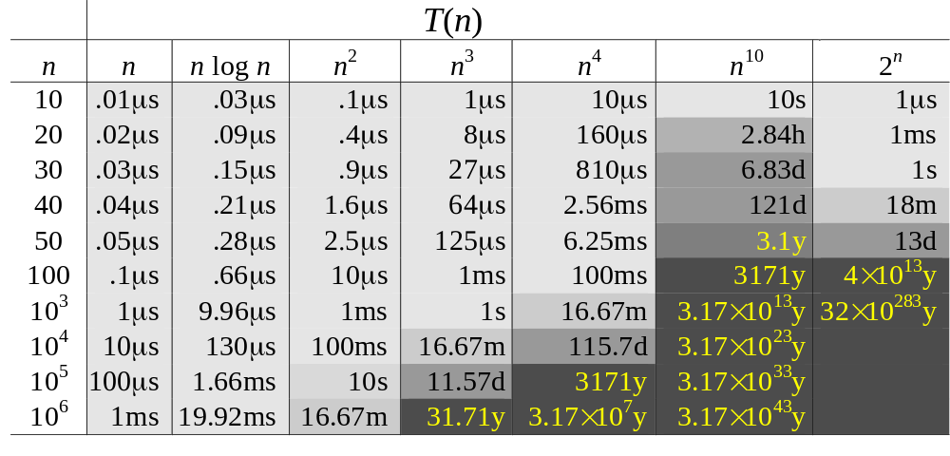
Complexity and Tractability
Assume the computer does 1 billion ops per sec.

Slide 21
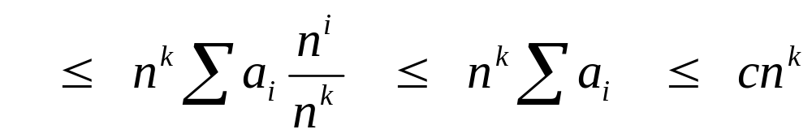
Big O Fact
A polynomial of degree k is O(n^{k})
Proof:
  Suppose f(n) = b_{k}n^{k} + b_{k-1}n^{k-1} + … + b₁n + b₀
    Let a_{i} = | b_{i} |
  f(n) ≤ a_{k}n^{k} + a_{k-1}n^{k-1} + … + a₁n + a₀

Slide 22
Simplifications
Keep just one term!
  the fastest growing term (dominates the runtime)
Asymtotic behavior (as n gets large) is determined entirely by the leading term.
  Example. T(n) = 10 n³ + n² + 40n + 800
    If n = 1,000, then T(n) = 10,001,040,800
    error is 0.01% if we drop all but the n³ term

Slide 23
Runtime Analysis
Two important rules
  Rule of sums
    if you do a number of operations in sequence, the runtime is dominated by the most expensive operation
  Rule of products
    if you repeat an operation a number of times, the total runtime is the runtime of the operation multiplied by the iteration count

Slide 24
Review
Operations on Stacks and Queues. Θ(1)
Linked List.
ADD/delete in the beginning is Θ (1)
Add/Delete at the end is Θ (n)
Search/iterative reverse is Θ (n).

Slide 25
Review
Recursive reverse is Θ (n²).
T(n)=n+T(n-1)
=n+n-1+n-2+n-3 + …+1
=n(n-1)/2
Θ(n²)

Slide 26
Iterative Recursion
voidreverse (struct List **head){
struct List *p = NULL, *c = *head, *n; while (c) {
n = c->next;
c->next = p;
p = c;
c = n; }
*head = p;}
p
c
n

Slide 27
Floyd’s Cycle Finding Algorithm
bool Cycle (struct List *node){
struct List *t1,*t2;t1=t2=node;
while (t2) {
t2=t2->next;
if (t2==t1) return true;
t1 = t1->next;
if(t2) t2=t2->next; }
return false;}

